Slide 1
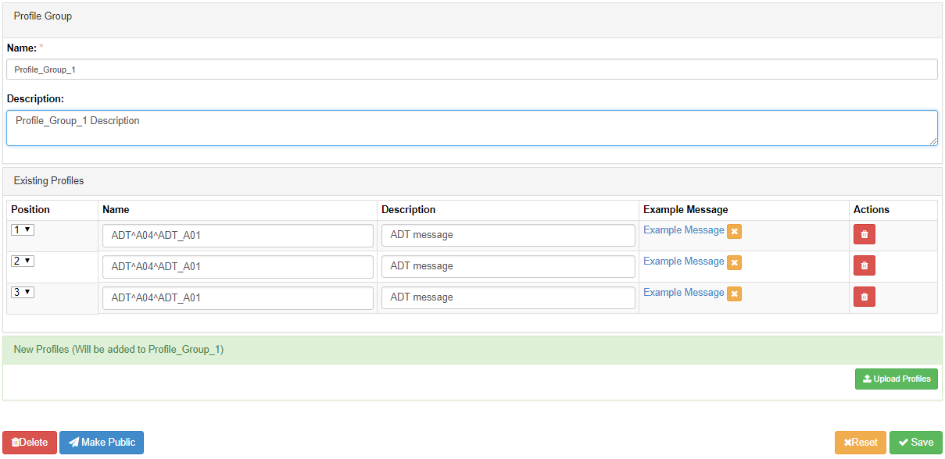
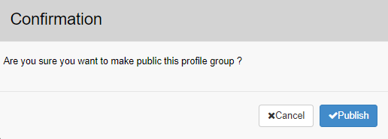
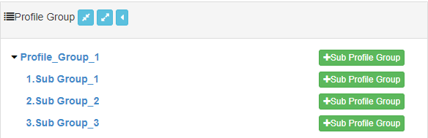
Context-Free Test Management: Making Profile Groups Public
Click √Publish to confirm and publish the Profile Group.
2
The Profile Group displays under the Public tab
On the Profile Group window, click Make Public.
3
1
Making the Profile Group Public will make it available to all GVT users, if the Tool Scope is also Public. Once a Profile Group is made Public, it cannot be made Private. Therefore, any updates to a Public profile group will automatically be available to all GVT users if the Tool Scope is Public.

